Slide 1
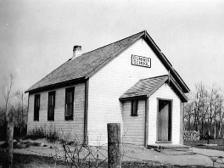
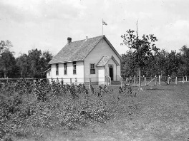
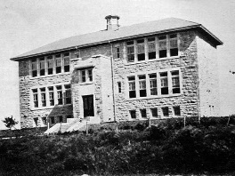
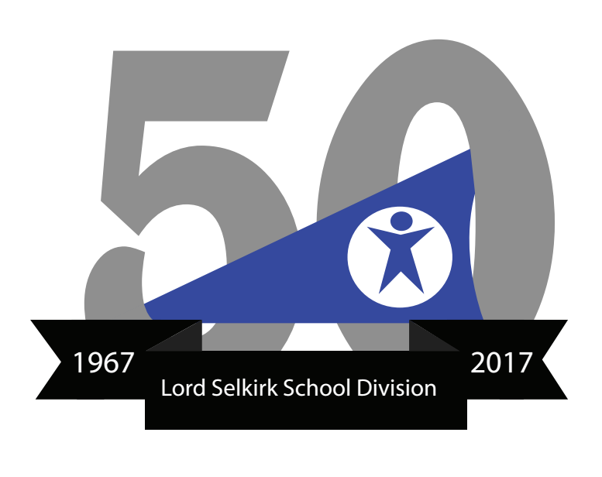
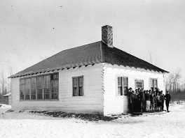
On February 15, 1967, by an Order-in-Council, the Lord Selkirk School Division was given jurisdiction over all education for grades 1 to 12 and the 40 rural school districts within its area were dissolved. This active period of educational transition saw the sale of property, the assembly of lands, consolidation of schools and school closures.
The school districts of Armistice and Hartley were transferred to the Interlake School Division No. 21. Titles transferred to the LSSD in 1967 included Dunara No 1203, Lockport No. 6, Cloverdale No. 577, Balsam Bay No. 859, Early Grey No. 1527, Netley Lake No. 775, and Hillside Beach No. 1980. Immediately following amalgamation, numerous properties and buildings were sold.
The Happy Thought School District No. 1452 was consolidated and turned over to the LSSD, bringing with it Ashfield No. 428, Hoey No. 2173, Kitchener No. 1076, Walkley No. 1285 Mayfield No. 1473, Brookside No. 1546, Highland No. 128, and Patapun No. 1636.
Amalgamation changed what had been a multi-district division into a unified division, encompassing all levels of education within its boundaries.

